Slide 1
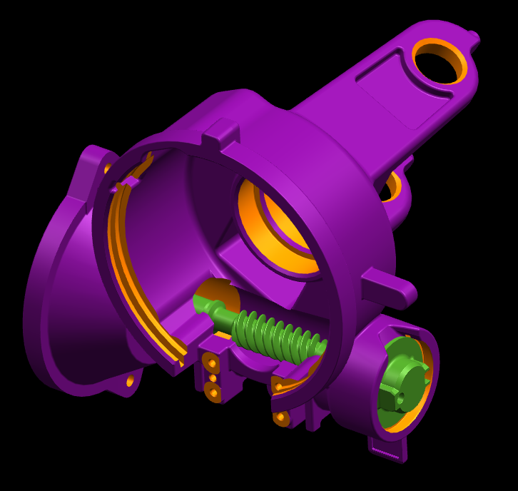
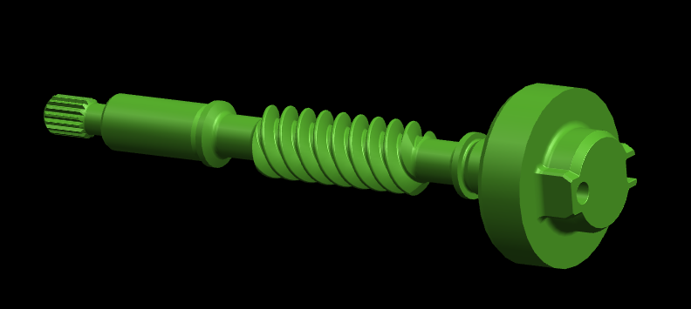
CCM-77: Eccentric Worm
Last updated: 15MAR15
Description
Adjustable torque range using offset bearing sleeve
Eliminates need for worm zones
Motivation: 2.0
Deliverables
MQ, PV Build success
Plant FTQ
Timing
Pass Haitec PPAP – 15JUN15
Complete Haitec SOP – 01SEP15
Team Members/Customers
Team names: Adam Lee / Jeff Beyerlein
Customers: Applications Team

Slide 2
CCM-77: Eccentric Worm
Last updated: 15MAR15
Status Update:
Haitec PV1 Complete – 21NOV14
Haitec PV2 Complete – 27JAN15
Created relationship and predictive program for adjustment – 19MAR15
Challenges:
Optimizing logic for adjusting backdrive
Understand impact on backdrive parameters
Next Actions:
Improve accuracy and precision of adjustment program

